Slide 1


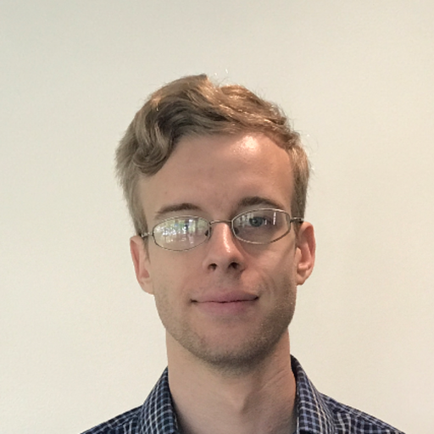


UNH SEDS
The Hungriest Engineers
Spring 2020 [February]
Cornelis Plomp
Alice Wade
Jacob Harrison
As part of the Frame team, Cornelis has done incredible and thorough work on the rocket frame. Ensuring that each of his parts is tested and proven through calculations and SOLIDWORK FEA.
Alice has been a superstar since the first day that she joined SEDS. Her dedication to Frame, Finance, and the organization has been outstanding. Check out our amazing website https://unhseds.org/ curtesy of this hungry engineer!
As part of the Avionics team, Jacob has worked like crazy to put together our launch and control box. Writing code and testing, Jacob has been key to the first cold fire test and all our Raspberry pi projects.

